Slide 1

Tennis Predictions
Elo, Glicko-2, and
Rank Points Logistic Regression
By Will Mohr

Slide 2
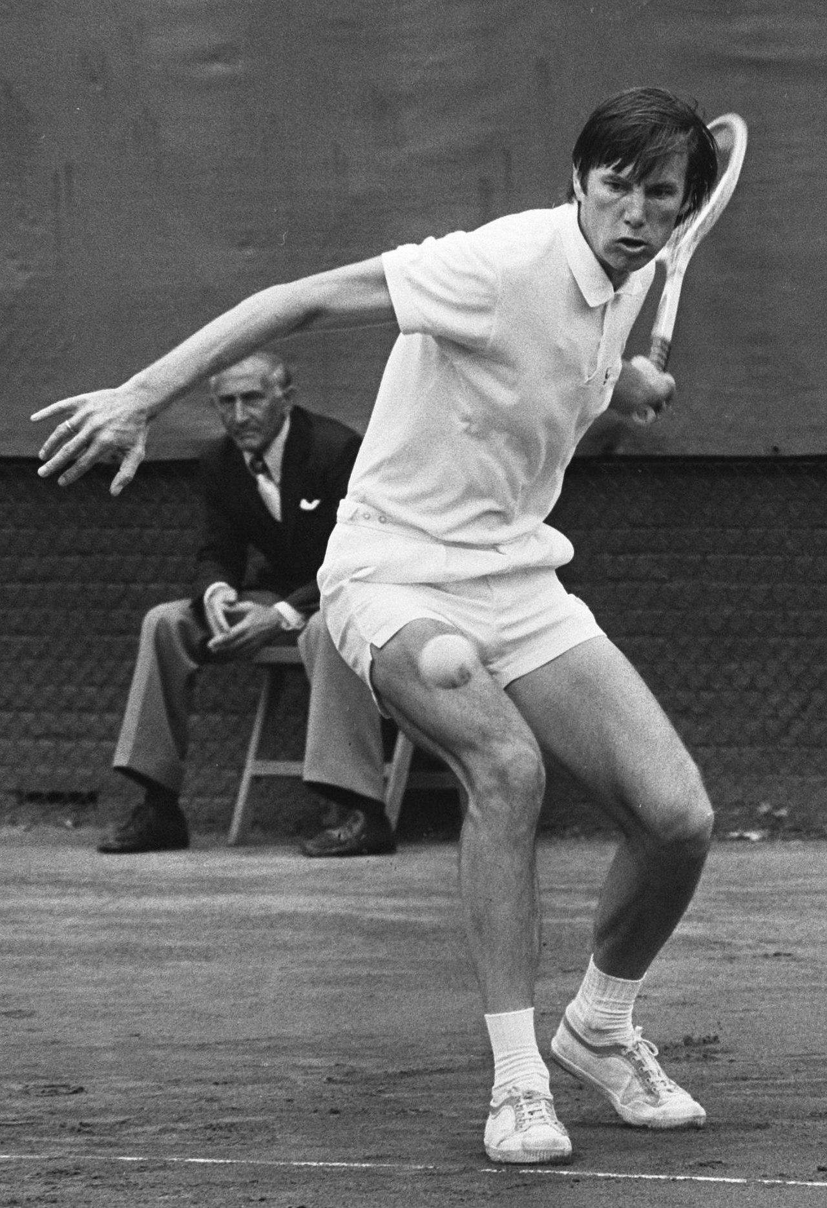
Origin of ATP Rankings
The ATP, or Association of Tennis Professionals, requires a transparent system for determining
Player seeding in tournaments
Qualification for tournaments
Prior to 1973 draws were subject to the whims of national and tournament-level management.
The ATP took the mantle after a Wimbledon boycott and objectified tournament entry.
The tour becomes more competitive and meritocratic
Notes:
Nikola Pilić,

Slide 3
Evolution of ATP Rankings
1968-1973
1990
2000
23 Aug, 2023
Star system
Average system
Max participation
Ad infinitum…
Preference given to big names and national champions
No official rankings
52 week total points divided by tournaments played, min 12
Bonus for defeating seeded and later on high ranking players
18 events contribute, including all 13 at the majors and masters level
Top 5 International Series performances
50th anniversary
Notes:
>1973> points = Tournament purse, draw size and quality. Maximum participation not encouraged, tournament surface and size dominated sign up decisions. >1990> “Best of 14”, similar model to downhill skiing. Tournaments grouped by Grand Slams, Championship Series, etc. >

Slide 4
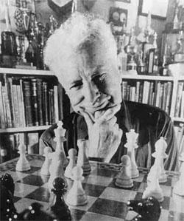
What is Elo?
Elo is the basis for the FIDE rating system in international chess
Its simplicity and ease of implementation has made it a go-to rating system
Nate Silver’s Five-Thirty-Eight ranks NFL teams with an Elo model

Slide 5
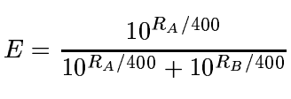
Elo Properties
Opponent rating and match outcome determine rating change
Normally distributed performances
Performance variance identical for all players
Binary update speed parameter according to professional status
Change in rating: update rate K times score minus expected score, or K*(S - E ), where

Slide 6

What is Glicko-2?
Developed by Mark Glickman
Removes Elo assumption of identical variances, with individualized Rating Deviations
Compared to Glicko, introduces rating volatilities, which capture idiosyncratic and non-stationary variation in performance level

Slide 7
Framework for Elo and Glicko-2 Application
A yearlong epoch generated expected and actual outcomes for each player
Ratings then update and a timestamped record of the new rating is recorded
Another function deploys this over the entire dataset
Thus at the end of every epoch is a record of players ratings at that time
These records are referenced to determine the most recent ratings for each match

Slide 8
Implementation Process – Glicko-2
I utilized Ryan Kirkman’s pyglicko2 python implementation.
Each player is represented by a class that carries the ratings, rating deviations, volatilities, and a parameter Tau which constrains the update of a player’s volatility.
The convoluted update process drained memory and limited the scope of debugging activities.
I divided the data into over 50 mini-batches.
These batches limited the number of epochs to at times under a year of match play.
The algorithm skipped over some matches that could not compute, necessitating later filtering.

Slide 9

The Data
Nearly 900,000 men’s singles matches from 1877 to 2022
Database maintained by Jeff Sachman
Data filtered to around 600,000 matches to ensure comparability between prediction methods
This naturally skewed the analysis to the post 1973 era when official rankings became available

Slide 10
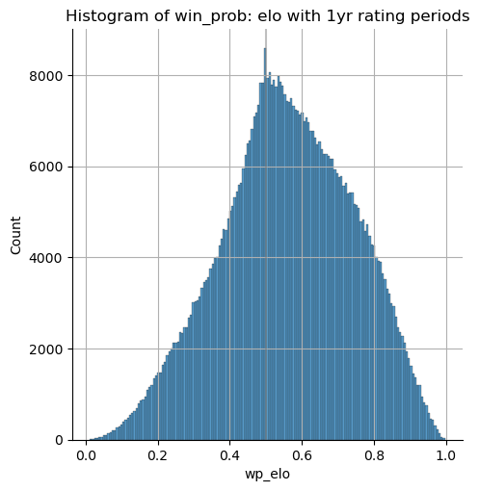
Elo Generated Win Probabilities
Note the spike at win prob = .5
The number of wins with win_prob .4 is only slightly above two thirds the number of wins with win_prob of .6
There are in the ballpark of 25% of the number of wins with a prob of .2 compared to .8
At .9 win_prob there appears to be only around 5x the number of wins as at .1

Slide 11
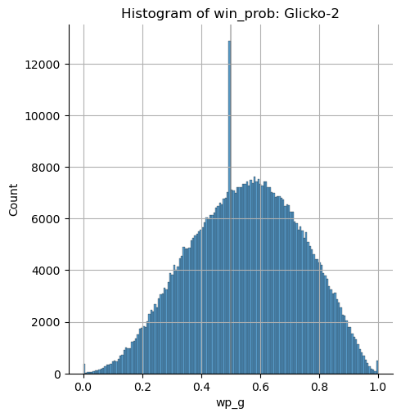
Glicko-2 Win Probabilities
More matches than with Elo between players not yet seen before.
Glicko-2 deployment employed a try-except clause.
Mode is around .58, After accounting for matches between unrated players,
Bell curve shape

Slide 12
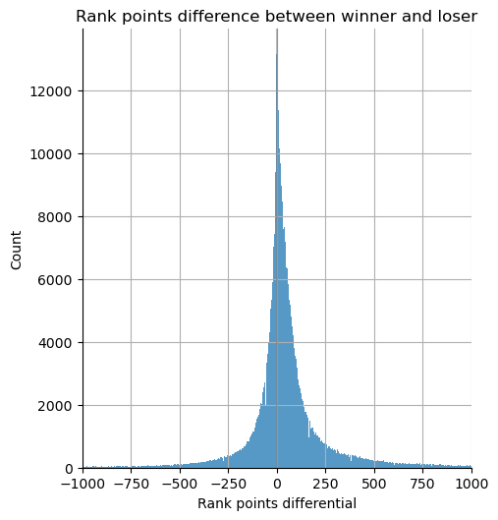
Rank Points Differential
Mode very close to zero
Center of mass is right of zero
Mean is positive at 120
Notes:
Mean close to zero is plausible as we would expect similarly rated players to compete with each other most regularly.

Slide 13

Randomization
Elo and Glicko-2 ratings as well as rank points were identified based on outcome
Thus, it was necessary to randomize the data into two classes independent of outcome

Slide 14
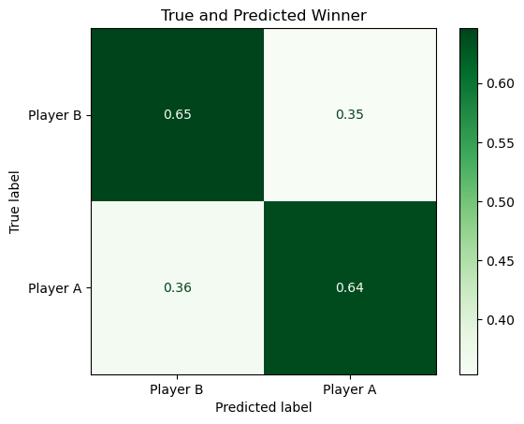
Rank Points Logistic Regression
Rank points differential used as sole feature in logistic regression
Prediction probability mathematically very similar to Elo
Around 64.5% accuracy
Player classes not meaningful in and of themselves, but an artifact of modeling pipeline
Notes:
No intercept, no majority or minority classes.

Slide 15
Logistic Regression
Classification Report
Precision: of all the predicted wins, 64.29% are actual wins
Recall: of all the actual wins, 64.29% were predicted to be wins
F1-score: harmonic mean between these two metrics, or 2*(precision*recall)/(precision + recall).
F1-score: 0.6429
Precision : 0.6429
Recall : 0.6429
Support: 150,200

Slide 16
Elo and Glicko-2 Performance
Elo generated an accuracy of 63%
Glicko-2 scored an accuracy of 60.8%
Filter for non-1500 ratings and re-evaluate
Elo: 63.25% with 97% of data remaining
Glicko-2: 61.77% with 95% of data remaining
MSE: 0.23, 0.23, and 0.36 for Elo, Glicko-2, and logistic respectively

Slide 17

Conclusions
There is no improvement in win prediction with Elo and Glicko-2
The probabilities associated with predictions are better with Elo and Glicko-2 according to MSE
For betting, predicting the winner with rank points and judging confidence with Elo or Glicko-2
As is, the complexity of Glicko-2 is not justified

Slide 18
Next Steps
For Elo, see if factoring number of matches informs the quality of prediction
Stratify analysis by tournament prestige
Applications: first match on tour, can apply Elo or Glicko based on amateur results
Tune Elo and Glicko-2 with different values for epoch size and volatility restraint parameters
Leverage prediction probabilities in monte-carlo simulations of tournaments
Identify bugs in Glicko-2 implementation - dig into source code, compare with algorithm updates
Explore additional rating algorithms such as the application of the graph-based PageRank

